Slide 1
FUEL AUTOMATION SYSTEM

Slide 2
ABSTRACT
Day by day the number of vehicles and machines are increasing in the modern world. In the present day's scenario, the demand of fuel is increasing because of vehicles and machines are depending on fuel. The long line in front of fuel stations, especially in front of gas pumps is a common scenario in the daily life that waste the valuable time. In Bangladesh, the fuel stations are operated manually that causes the delay. In this paper, we have developed an automated fuel management system that can maintain the account of the fuel stations. The results of this experiment print a receipt automatically after every transaction and can monitor the transactions from remote place via Internet. This management system also helps the fuel stations to become faster and can reduce corruptions in transactions of fuel stations.

Slide 3
INTRODUCTION
Energy is a vital issue in the modern world. At present, the machine is part of parcel of the daily life. Moreover, most of the machines are depending on energy or fuel in order to operate. The modern life depends on energy and most of the energy is coming from Petroleum or natural resources. Most of the countries in the world have not available petroleum or other natural resources. They have some small amount of natural Gas mine which is not good enough for a long time. Maximum developing country's government imports a large amount of petroleum in every year and sells them at fewer prices than the international market. The government of Bangladesh gives a large amount of subsidy in petroleum sector every year. The government of Bangladesh spends a major share of its budget providing direct subsidies for fossil fuels and electricity, the costs of which have been escalating rapidly in recent years. In 2012, the government reports it spent BDT 81.4 billion (US$ 944 million) in direct expenditure on energy subsidies [1]. In 2014 the finance ministry has sanctioned BDT 1,253 core in favor of the Bangladesh Petroleum Corporation as subsidy payments for selling petroleum products in the domestic market at prices lower than its procurement costs [2]. A well monitoring is necessary in this sector. The idea is to develop such a system that can monitor every transaction of every fuel station (e.g. Petrol or CNG pump). The central goal of this research is to automate the fuel station so that the transactions can be maintained without difficulty.

Slide 4
HARDWARE SPECFICATION
Processor : P 4 700 GHz.
RAM : 4 GB RAM
Hard Disk Drive : 180 GB

Slide 5
SOFTWARE SPECIFICATION
Operating System : Windows 7/8/10
Front End : JAVA
Back End : SQL

Slide 6
EXISTING SYSTEM
In present system all report work is done manually at the petrol pump. Admin user have to check each petrol pump machine the calculate the sold petrol, but in our proposed system user can check sold petrol from his monitor by clicking on some report button. This system also keep records of each employee. Admin can also check which employee sold how much petrol and what amount he submitted to accountant at the end of the day. Admin can also check how much oil they sold in one day or one month. Admin can generate monthly sale report or annually sale report when they want. This system also help admin to generate the salary of each employee on the basis of his position and working hour.

Slide 7
PROPOSED SYSTEM
As the work at petrol pump is done manually so it becomes hard for the supervisor to maintain a daily record. So we have developed this system to computerize all the reporting work of petrol pump. Our project gives the supervisor to maintain a daily record in an easiest way. Admin can add new employee and can also delete employee from the system. this system also keep track of the employee attendance and generate the salary on the basis of his working hours. Employee can also check the petrol diesel price online. Admin can also find contact detail of every employee from the system. he can find detail like his address , phone number , joining date , native address.
From report module admin can also generate several reports like pumps daily earning report , employee shift delivery report , pumps report , cumulative daily report , salary report. Admin can update many information in the system that’s why his account is protected with user name and password. Only authentic user can login to admin account.

Slide 8
Types Of Modules
Admin
Customer
Maintenance
Sales
Balances

Slide 9
Modules
Admin
Admin has all the access to manage this application, but admin should enter correct username and password to access this application. If the admin given invalid username and password they won’t allow to access this application.
Customer
Admin click the customer module and managing the customer details. Admin have rights to add and manage the employees details. Admin should enter customer name, email, contact and address details. Also admin can have rights to edit and delete the customer details.

Slide 10
Maintenance
This module has all the details about the fuel and diesel brand and price details. can modidy and delete the records. Once it is created it will be stored in the maintanence table when ever data is needed can get it from the table.
Sales
This modue could be select the fuel type and price to calculte the price details. This module has to manage all the performance activity. Also we can select the customer and reduce the balance amount.
Balance
This module can be perform to calculate the amount on customer level, if the customer has any pending payment amount they can manually choose and pay the amount.

Slide 11
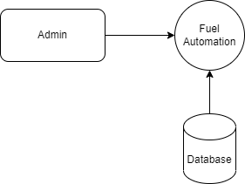
Data Flow Diagram
Level 0

Slide 12
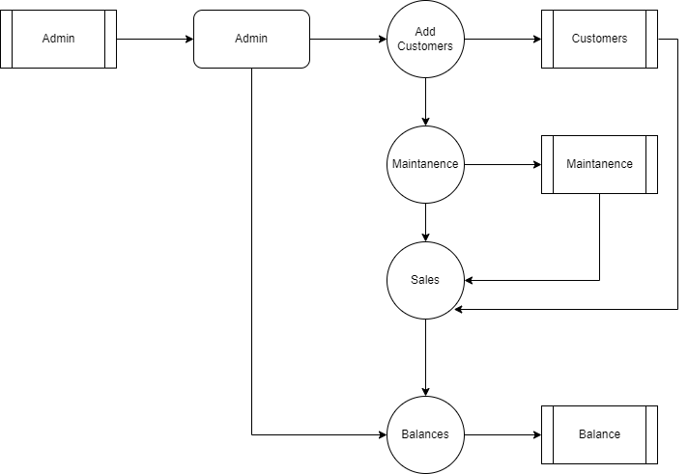
Level 1:

Slide 13
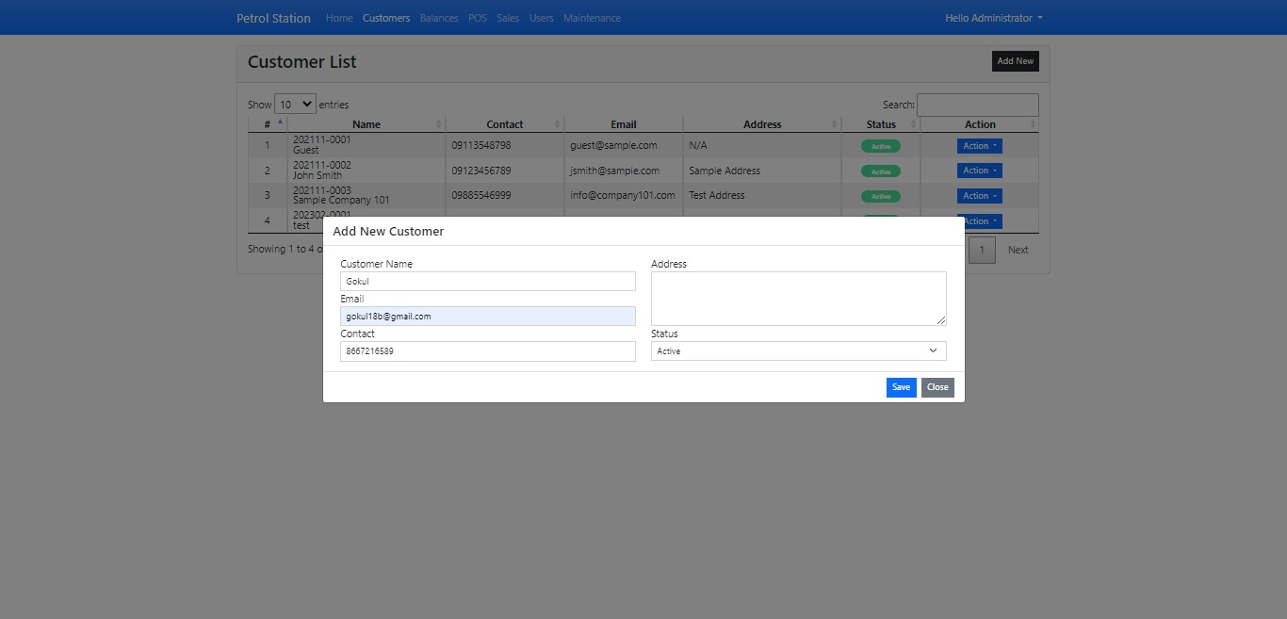

Slide 14
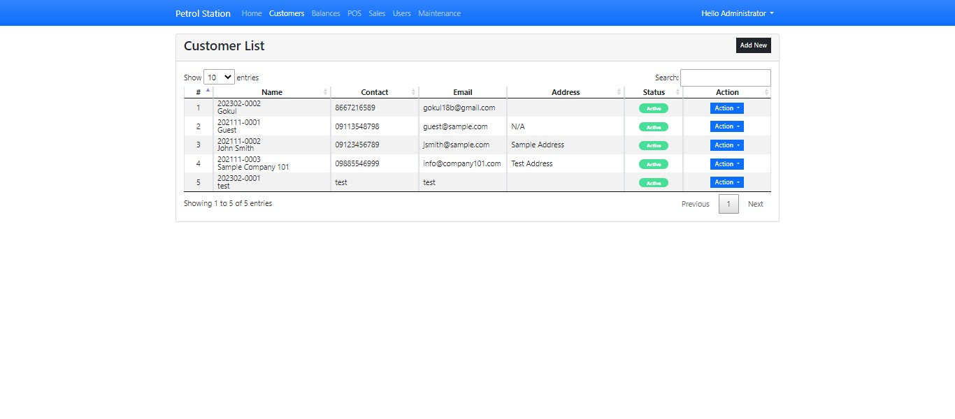
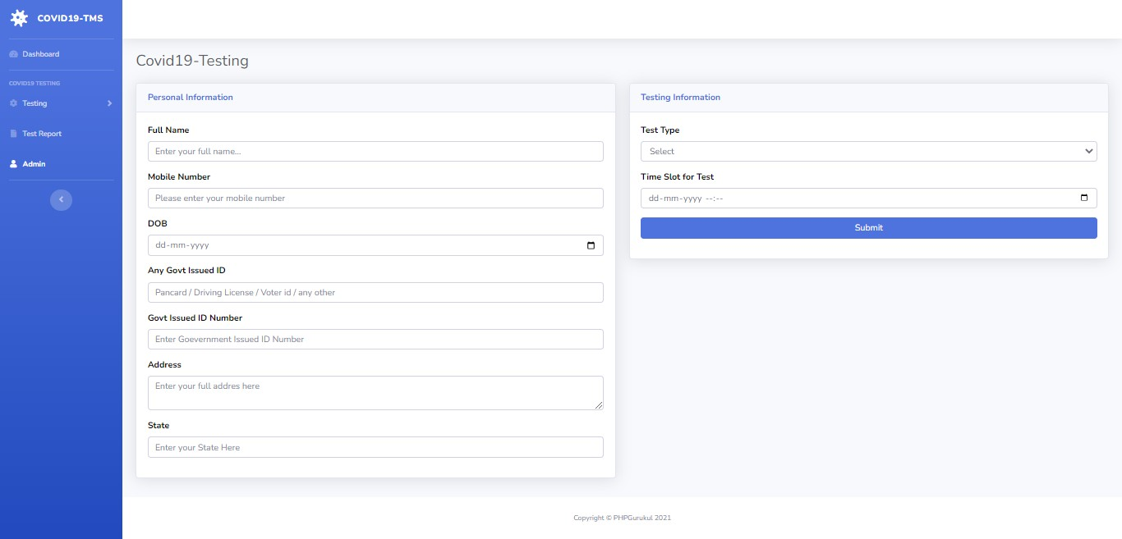

Slide 15
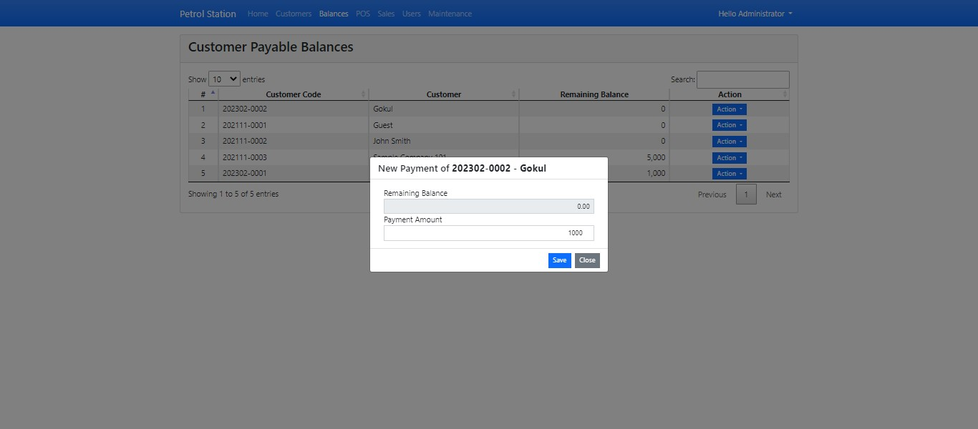

Slide 16
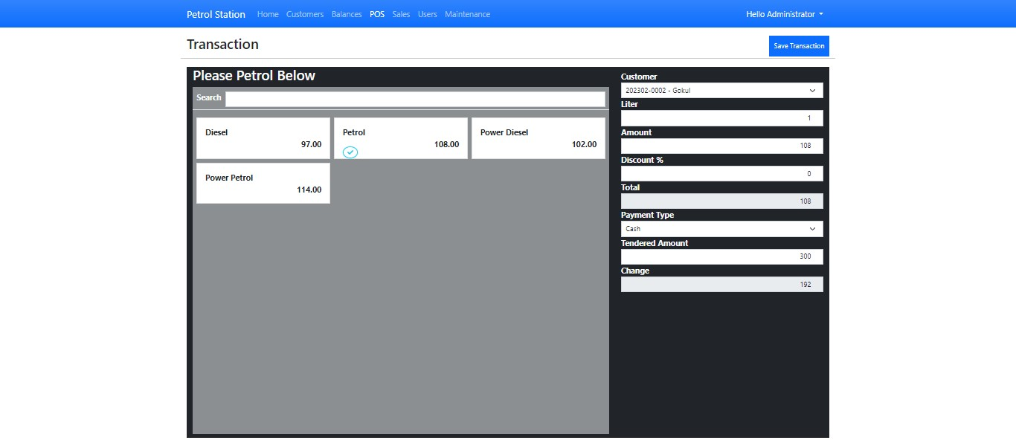

Slide 17
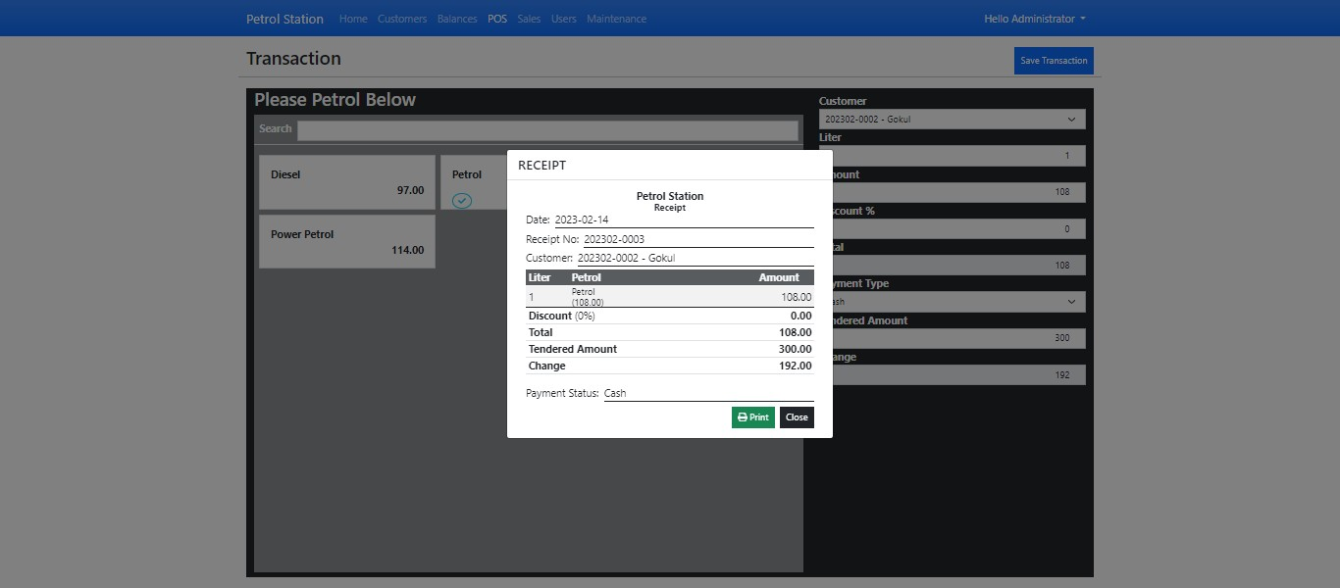

Slide 18
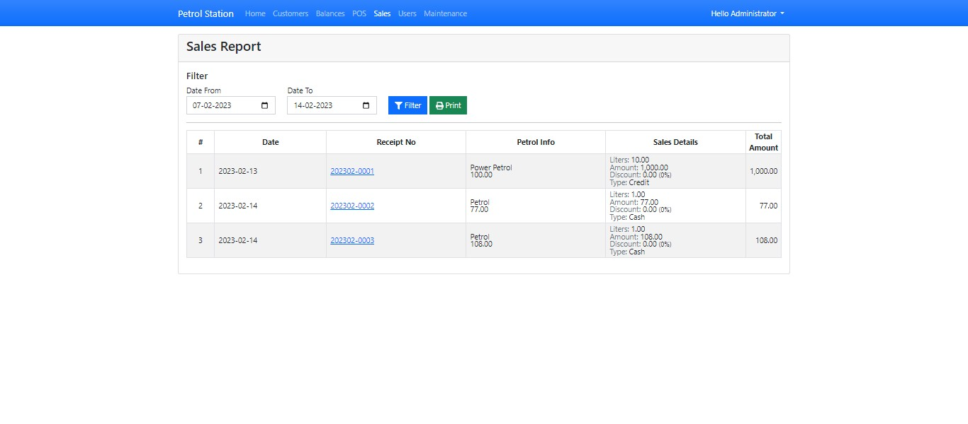

Slide 19
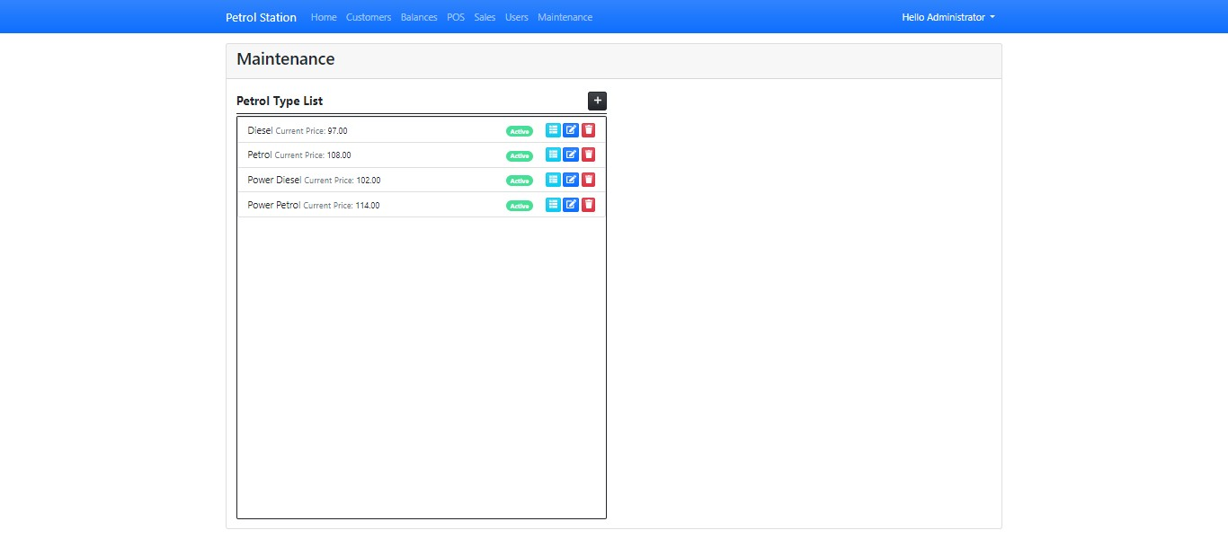
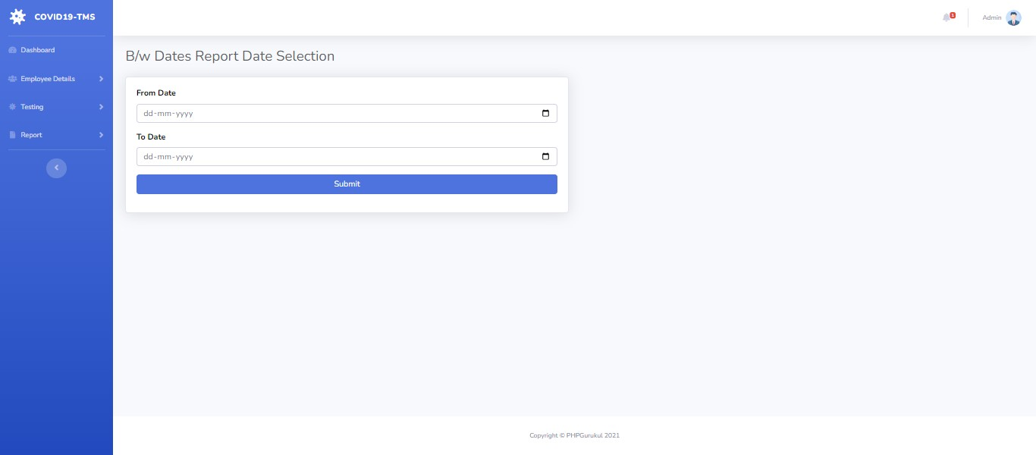

Slide 20
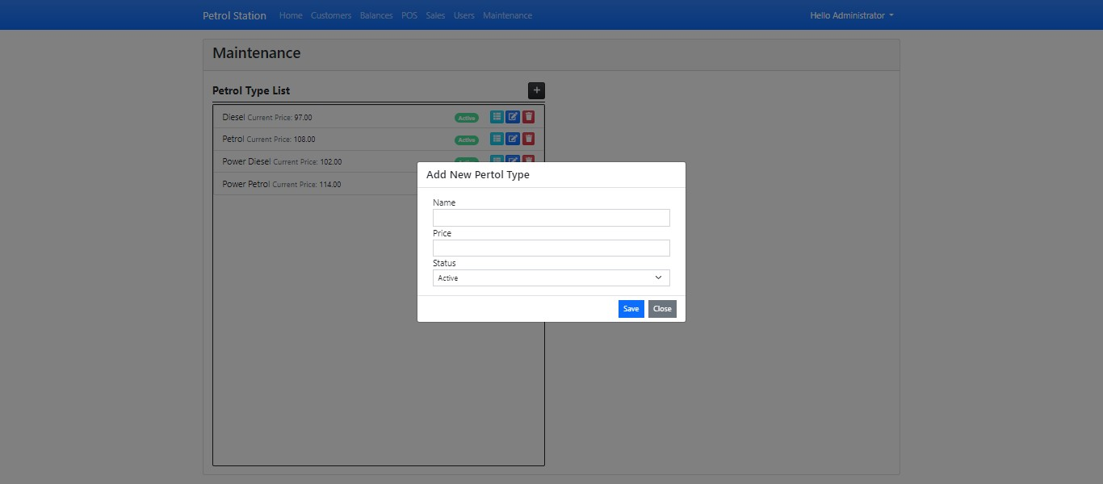

Slide 21
Thank You

